Slide 1
Implementing VLANs and Trunks

Slide 2
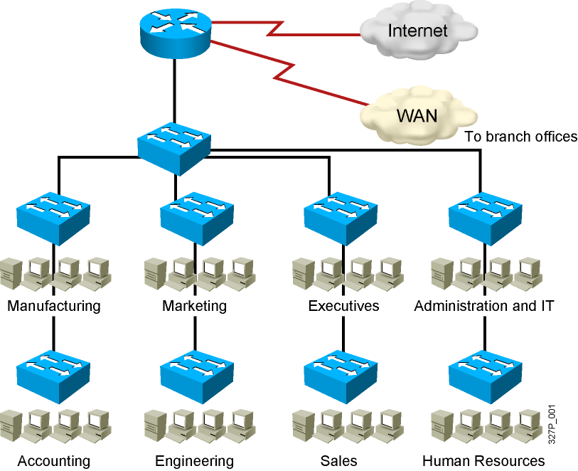
Issues in a Poorly Designed Network
Unbounded failure domains
Large broadcast domains
Large amount of unknown MAC unicast traffic
Unbounded multicast traffic
Management and support challenges
Possible security vulnerabilities

Slide 3
VLAN Overview
Vlan 1
F0/1
F0/2
F0/3
F0/4
F0/5
F0/6
F0/7
. . . F0/24
F0/1
F0/2
F0/3
F0/4
F0/5
F0/6
F0/7
. . . F0/24
Switch 1
Vlan 2
Switch 2
Vlan 3
Switch 3
Vlan 4
Switch 4
Switch A
Switch A

Slide 4
VLAN Overview
Vlan on Switching Network : 1 broadcast-domain
A
E
F0/1
Vlan 1
F0/2
Vlan 1
F0/1
B
F
F0/4
Vlan 2
F0/5
Vlan 2
F0/4
C
G
F0/6
Vlan 3
F0/7
Vlan 3
F0/6
D
H
F0/24
Vlan 4
F0/23
Vlan 4
F0/24
Switch A
Switch B

Slide 5
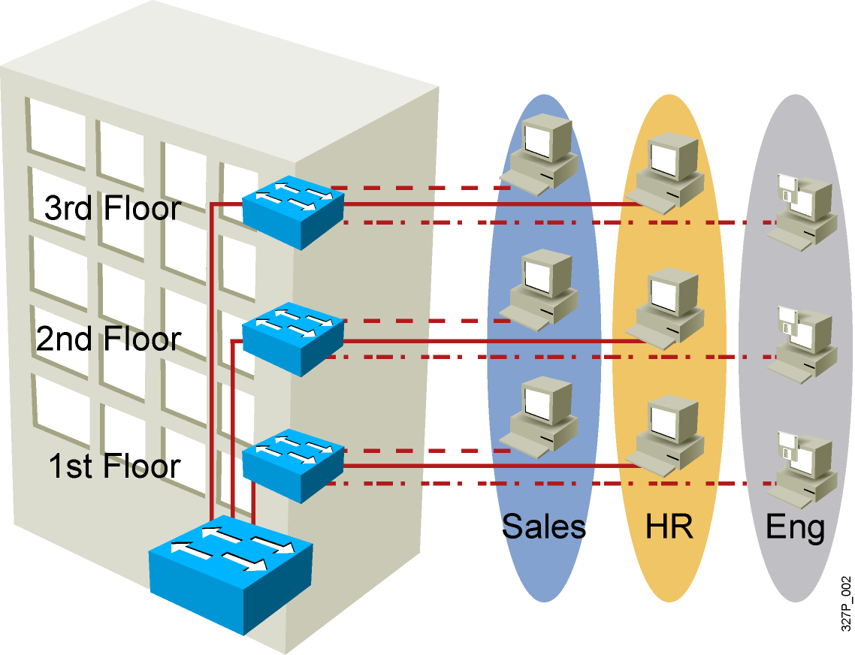
VLAN Overview
Segmentation
Flexibility
Security
VLAN = Broadcast Domain = Logical Network (Subnet)
Notes:
Purpose:
Emphasize: A VLAN is a broadcast domain.
Note: In order to have inter-VLAN communications, a router is required.

Slide 6
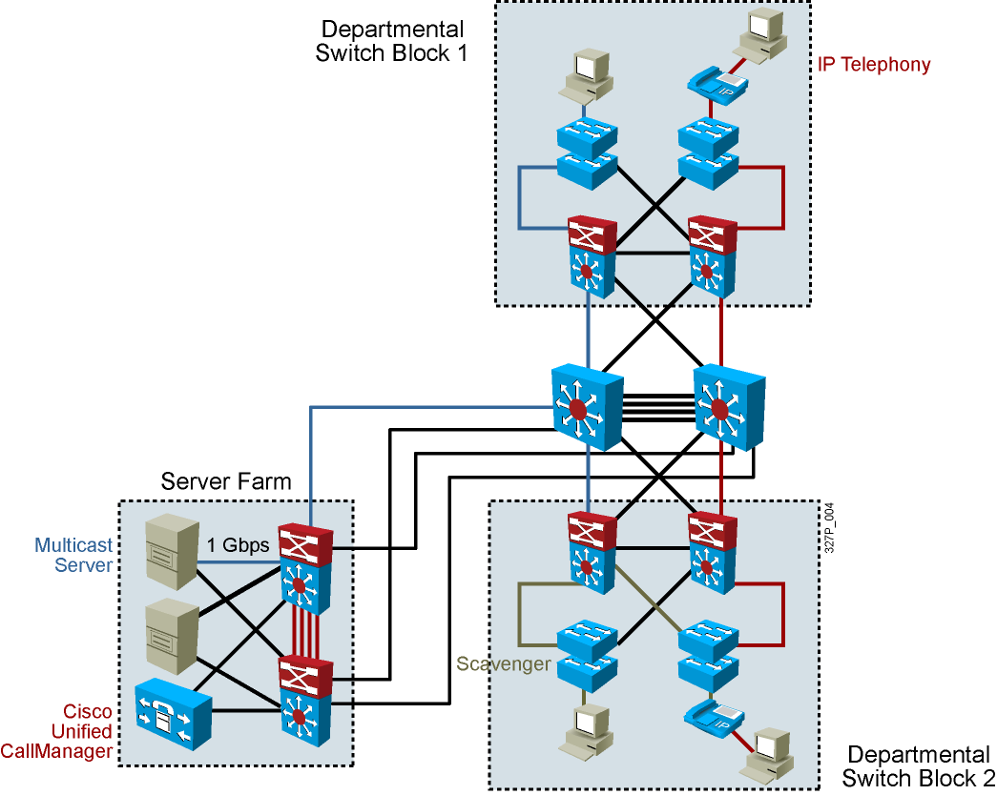
Network Traffic Types
Traffic types to consider when designating VLANs:
Network management
IP telephony
IP Multicast
Normal data
Scavenger class

Slide 7
Designing VLANs for an Organization
VLAN design must take into consideration the implementation of a hierarchical network addressing scheme.
The benefits of hierarchical addressing are:
Ease of management and troubleshooting
Minimization of errors
Reduced number of routing table entries

Slide 8
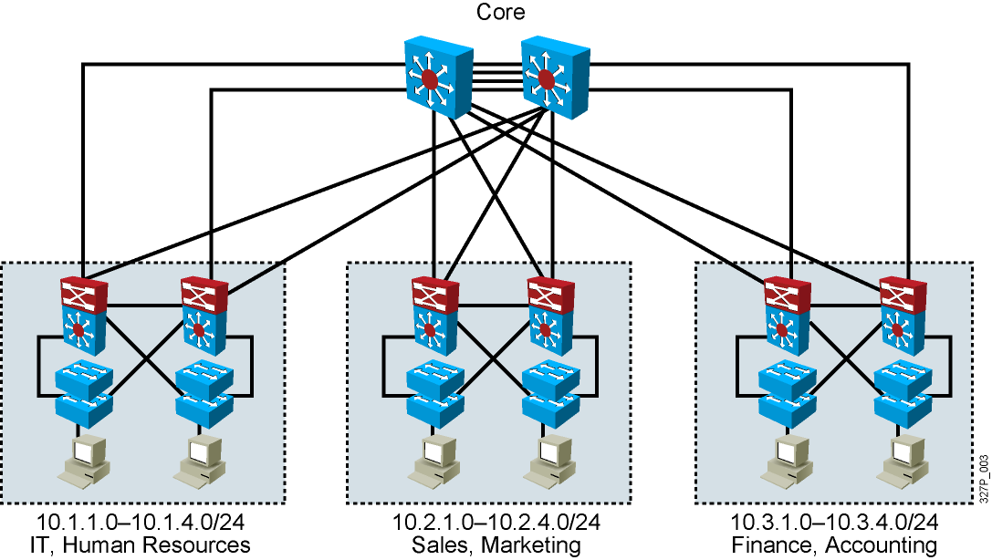
Guidelines for Applying IP Address Space
Allocate one IP subnet per VLAN.
Allocate IP address spaces in contiguous blocks.

Slide 9
VLAN Creation Guidelines
The maximum number of VLANs is switch-dependent.
Most Cisco Catalyst desktop switches support 128 separate spanning-tree instances, one per VLAN.
VLAN 1 is the factory default Ethernet VLAN.
Cisco Discovery Protocol and VTP advertisements are sent on VLAN 1.
The Cisco Catalyst switch IP address is in the management VLAN (VLAN 1 by default).
If using VTP, the switch must be in VTP server or transparent mode to add or delete VLANs.
Notes:
Note: In the ICND lab, all the switches and routers are in VLAN1. The core server and the core router are in multiple VLANs. Each workgroup PC is on an unique VLAN.

Slide 10
Adding a VLAN
SwitchX# configure terminal
SwitchX(config)# vlan vlan-id
SwitchX(config-vlan)# name vlan-name
Notes:
Layer 2 of 2
12 bit vlan id -> 0 -> 4095
0 and 4095: reserve
1->1001: normal VLAN
1002->1005: communicate with others LAN (token-ring; FDDI)
1006-4094: extended VLAN, use in transparent mode
VLAN 1, 1002, 1003, 1004, 1005: Default VLAN

Slide 11
Verifying a VLAN
SwitchX# show vlan [brief | id vlan-id || name vlan-name]
SwitchX# show vlan id 2
VLAN Name Status Ports
---- -------------------------------- --------- -------------------------------
2 switchlab99 active Fa0/2, Fa0/12
VLAN Type SAID MTU Parent RingNo BridgeNo Stp BrdgMode Trans1 Trans2
---- ----- ---------- ----- ------ ------ -------- ---- -------- ------ ------
2 enet 100002 1500 - - - - - 0 0
. . .
SwitchX#
Notes:
Layer 2 of 2
Note:
Type: Default is Ethernet (other types are FDDI and Token Ring).
SAID: Is used for FDDI trunking.
MTU: Default is 1500 for Ethernet VLAN.
STP: The 1900 only supports 802.1d Spanning-Tree Protocol. It does not support DEC or IBM Spanning-Tree Protocol. Routers support all three Spanning-Tree Protocol standards.
Other parameters: Used for Token Ring or FDDI VLANs.

Slide 12
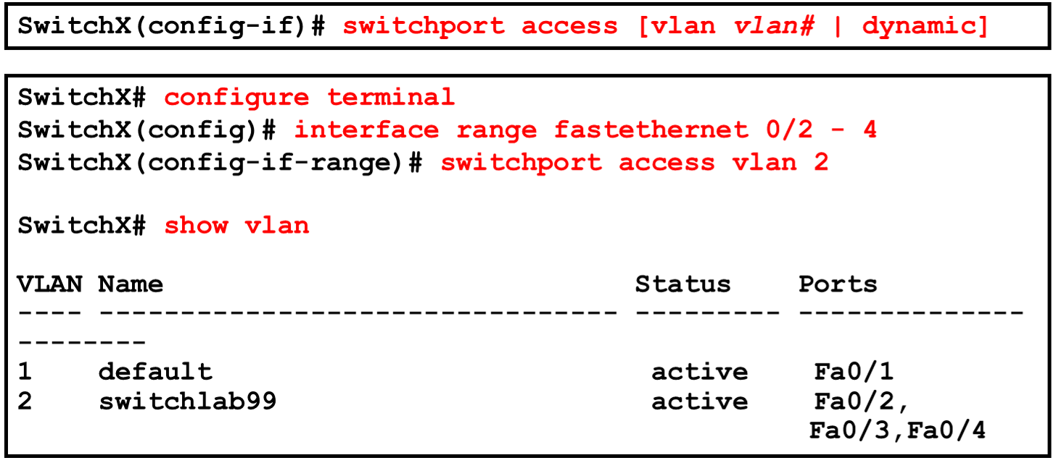
Assigning Switch Ports to a VLAN

Slide 13
Verifying VLAN Membership
SwitchX# show vlan brief
SwitchX# show vlan brief
VLAN Name Status Ports
---- -------------------------------- --------- -------------------------------
1 default active Fa0/1
2 switchlab99 active Fa0/2, Fa0/3, Fa0/4
3 vlan3 active
4 vlan4 active
1002 fddi-default act/unsup
1003 token-ring-default act/unsup
VLAN Name Status Ports
---- -------------------------------- --------- -------------------------------
1004 fddinet-default act/unsup
1005 trnet-default act/unsup
Notes:
Layer 2 of 2
Emphasize: Port 1 = e0/1, ……. AUI = e0/25, A = fa 0/26, B = fa 0/27

Slide 14
Verifying VLAN Membership (Cont.)
SwitchX(config-if)# show interfaces interface switchport
SwitchX# show interfaces fa0/2 switchport
Name: Fa0/2
Switchport: Enabled
Administrative Mode: dynamic auto
Operational Mode: static access
Administrative Trunking Encapsulation: dot1q
Operational Trunking Encapsulation: native
Negotiation of Trunking: On
Access Mode VLAN: 2 (switchlab99)
Trunking Native Mode VLAN: 1 (default)
--- output omitted ----
Notes:
Layer 2 of 2
Note: In the lab, we will only be configuring static VLAN membership.

Slide 15
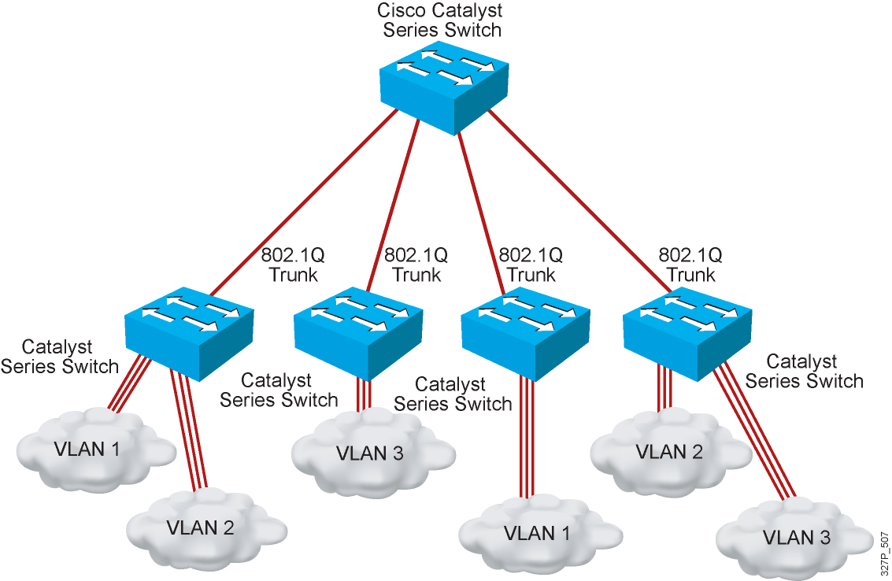
802.1Q Trunking

Slide 16
Trunking
F0/1
Vlan 10
Vlan 10
F0/1
F0/4
Vlan 20
Vlan 20
F0/4
F0/6
Vlan 30
Vlan 30
F0/6
Switch A
Switch B

Slide 17
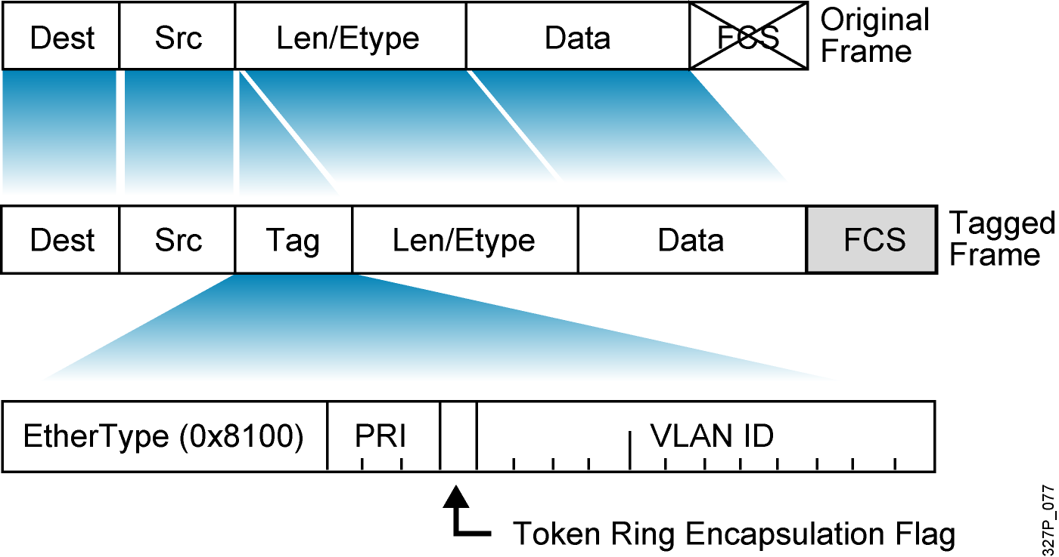
802.1Q Frame
Notes:
Ether type: 16bit
PRI: 3bit (Priority of frame)
Flag: 1bit
VLAN ID: 12 bit
-> Tag of trunk dot1q: 4byte
ISL: 26 byte: insert ISL Header at start of frame

Slide 18
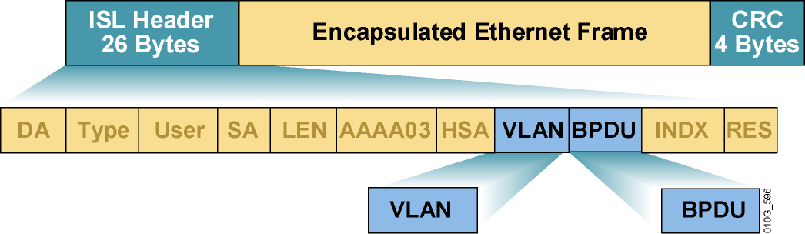
ISL Encapsulation

Slide 19
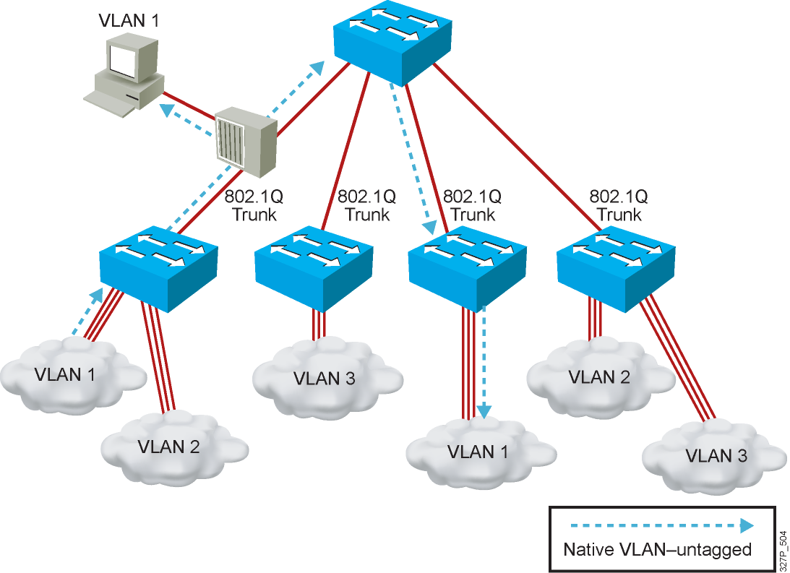
Understanding Native VLANs

Slide 20
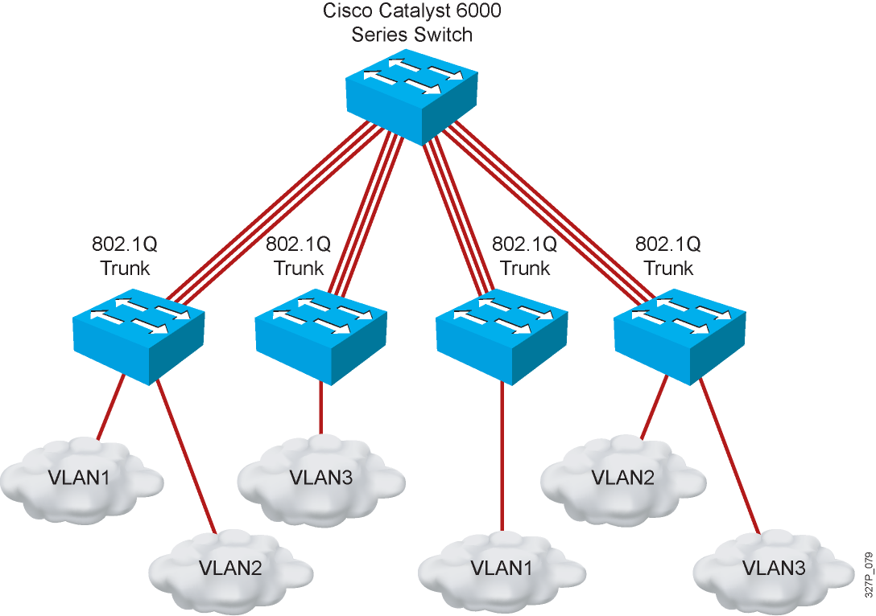
802.1Q Trunking Issues
Make sure that the native VLAN for an 802.1Q trunk is the same on both ends of the trunk link.
Note that native VLAN frames are untagged.
A trunk port cannot be a secure port.
All 802.1Q trunking ports in an EtherChannel group must have the same configuration.

Slide 21
Configuring 802.1Q Trunking
SwitchX(config-if)#
switchport mode {access| dynamic{auto|desirable}| trunk}
Configures the trunking characteristics of the port
SwitchX(config-if)#switchport trunk encapsulation {dot1q | isl}
SwitchX(config-if)#switchport mode trunk
Configures the port as a VLAN trunk
Notes:
Access Auto Desirable Trunk
Access
Auto
Desirable
Trunk

Slide 22
Verifying a Trunk
SwitchX# show interfaces interface [switchport | trunk]
SwitchX# show interfaces fa0/11 switchport
Name: Fa0/11
Switchport: Enabled
Administrative Mode: trunk
Operational Mode: down
Administrative Trunking Encapsulation: dot1q
Negotiation of Trunking: On
Access Mode VLAN: 1 (default)
Trunking Native Mode VLAN: 1 (default)
. . .
SwitchX# show interfaces fa0/11 trunk
Port Mode Encapsulation Status Native vlan
Fa0/11 desirable 802.1q trunking 1
Port Vlans allowed on trunk
Fa0/11 1-4094
Port Vlans allowed and active in management domain
Fa0/11 1-13
Notes:
Layer 2 of 2
Note: The Catalyst 1900,at the time of the beta, only supports ISL trunking. It does not support 802.1Q trunking.

Slide 23
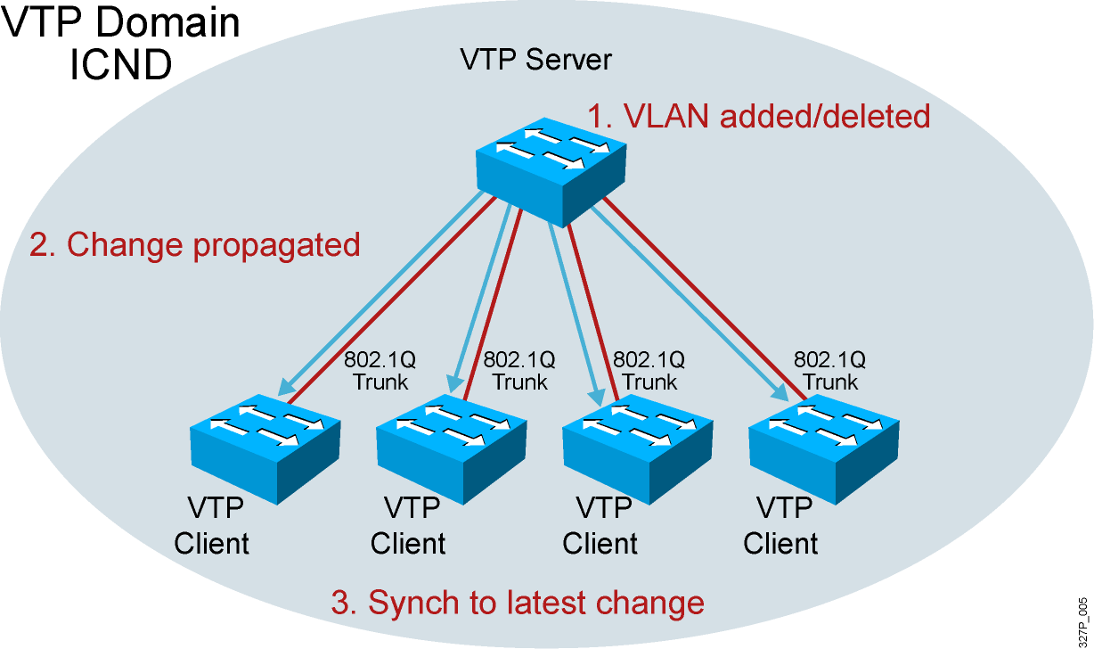
VTP Features

Slide 24
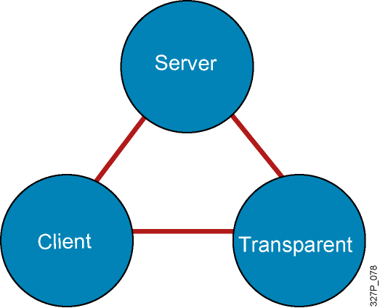
VTP Modes
Create VLANs
Modify VLANs
Delete VLANs
Sends and forwards advertisements
Synchronizes
Cannot create, change, or delete VLANs
Sends and forwards advertisements
Synchronizes
Create local VLANs only
Modify local VLANs only
Delete local VLANs only
Forwards advertisements
Does not synchronize
Notes:
Emphasize: Default VTP mode on the Catalyst switches is server. Be careful when adding new switches into an existing network. This is covered in more detail later.

Slide 25
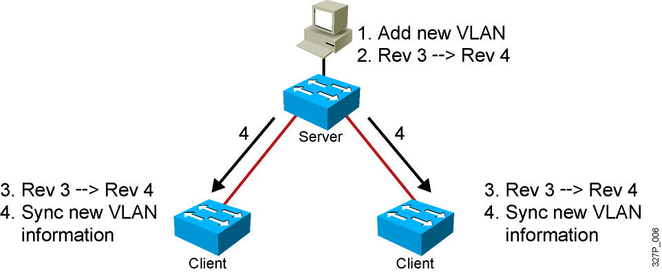
VTP Operation
VTP advertisements are sent as multicast frames.
VTP servers and clients are synchronized to the latest revision number.
VTP advertisements are sent every 5 minutes or when there is a change.
Notes:
Layer 2 of 2
Emphasize: The latest revision number is what the switches will synchronize to.

Slide 26
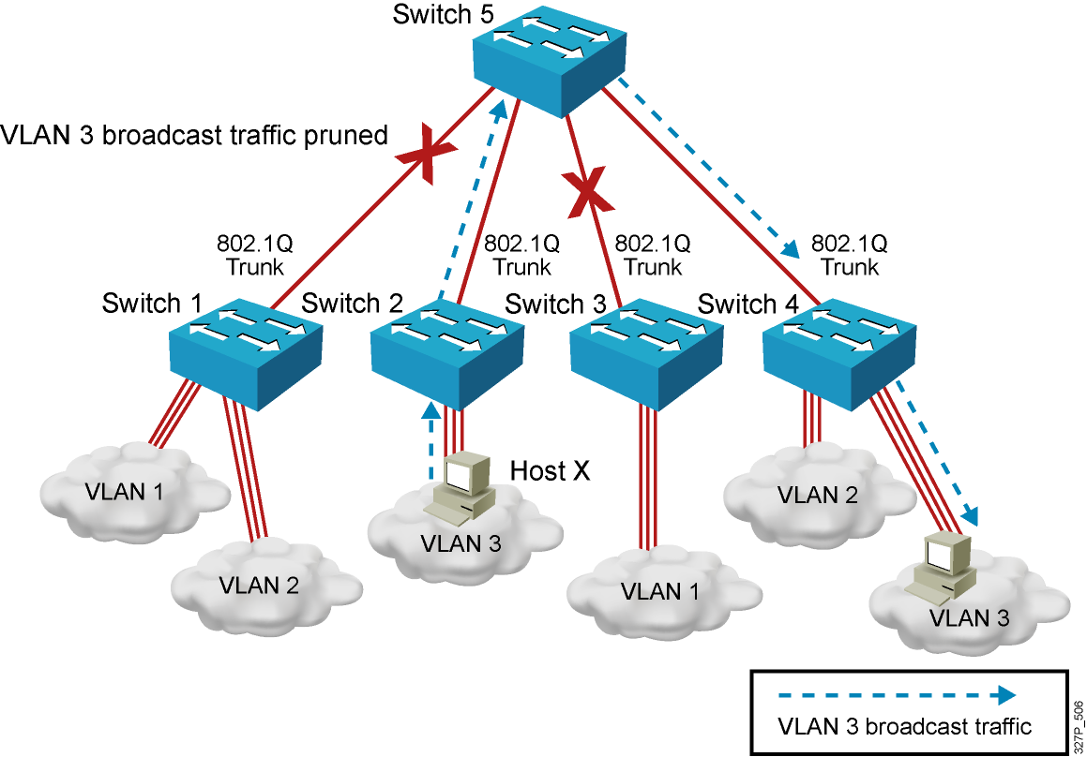
VTP Pruning

Slide 27
VTP Configuration Guidelines
VTP defaults for the Cisco Catalyst switch:
VTP domain name: None
VTP mode: Server mode
VTP pruning: Enabled or disabled (model specific)
VTP password: Null
VTP version: Version 1
A new switch can automatically become part of a domain once it receives an advertisement from a server.
A VTP client can overwrite a VTP server database if the client has a higher revision number.
A domain name cannot be removed after it is assigned; it can only be reassigned.
Notes:
Notes: All switches in a VTP domain must run the same VTP version.
The password entered with a domain name should be the same for all switches in the domain. If you configure a VTP password, the management domain will not function properly if you do not assign the management domain password to each switch in the domain.
A VTP version 2-capable switch can operate in the same VTP domain as a switch running VTP version 1, provided version 2 is disabled on the version 2-capable switch (version 2 is disabled by default).
Do not enable VTP version 2 on a switch unless all of the switches in the same VTP domain are version 2-capable. When you enable version 2 on a switch, all of the version 2-capable switches in the domain must have version 2 enabled. If there is a version 1-only switch, it will not exchange VTP information with switches with version 2 enabled.
If there are Token Ring networks in your environment, you must enable VTP version 2 for Token Ring VLAN switching to function properly.
Enabling or disabling VTP pruning on a VTP server enables or disables VTP pruning for the entire management domain.
In the lab, all the switches are set to VTP transparent mode.

Slide 28
Creating a VTP Domain
SwitchX# configure terminal
SwitchX(config)# vtp mode [server | client | transparent]
SwitchX(config)# vtp domain domain-name
SwitchX(config)# vtp password password
SwitchX(config)# end
Notes:
Layer 2 of 2
Note: The two commands shown in the slide can also be combined into one command:
vtp domain switchlab transparent

Slide 29
Configuring VLANs and Trunks
Configure and verify VTP.
Configure and verify 802.1Q trunks.
Create or modify a VLAN on the VTP server switch.
Assign switch ports to a VLAN and verify.
Execute adds, moves, and changes.
Save the VLAN configuration.

Slide 30
VTP Configuration and Verification Example
SwitchX(config)# vtp domain ICND
Changing VTP domain name to ICND
SwitchX(config)# vtp mode transparent
Setting device to VTP TRANSPARENT mode.
SwitchX(config)# end
SwitchX# show vtp status
VTP Version : 2
Configuration Revision : 0
Maximum VLANs supported locally : 64
Number of existing VLANs : 17
VTP Operating Mode : Transparent
VTP Domain Name : ICND
VTP Pruning Mode : Disabled
VTP V2 Mode : Disabled
VTP Traps Generation : Disabled
MD5 digest : 0x7D 0x6E 0x5E 0x3D 0xAF 0xA0 0x2F 0xAA
Configuration last modified by 10.1.1.4 at 3-3-93 20:08:05
SwitchX#
Notes:
240, 197, 102

Slide 31
Executing Adds, Moves, and Changes for VLANs
When using VTP, the switch must be in VTP server or transparent mode to add, change, or delete VLANs.
When you make VLAN changes from a switch in VTP server mode, the change is propagated to other switches in the VTP domain.
Changing VLANs typically implies changing IP networks.
After a port is reassigned to a new VLAN, that port is automatically removed from its previous VLAN.
When you delete a VLAN, any ports in that VLAN that are not moved to an active VLAN will be unable to communicate with other stations.

